Slide 1

Ontologies What is an ontology How to build an ontology next lectures: logics for ontologies & reasoning for ontologies)
Frank van Harmelen
Vrije Universiteit Amsterdam

Slide 2
Our story so far
In lectures until now we have seen
how to represent knowledge in a logic, and
how to use such a logic representation for problem solving
We used this in a simple world of Sudoku’s
Others are using this in the real world (software safety, hardware correctness, space planning)
But our representation (PL in CNF) was not very nice:
Quite hard to construct and quite hard to read
Became very big, even for small problems

Slide 3
Can we do better?
Can we think of a knowledge representation that
Is more useable by people (smaller, more readable)
Is still useable by computers (for efficient reasoning)
In the next lectures
Ontologies: a way of organizing knowledge that is useful for people
Description logic: a logic that allows computers to reason with ontologies

Slide 4
Definition(s) of an ontology
"An ontology defines the terms used to describe and represent an area of knowledge" - Jeff Heflin
"An ontology
defines the basic terms and relations
that form the vocabulary of a topic area
as well as the rules for combining terms and relations
to infer extensions to the vocabulary" - Neches ('91)
The goal of an Ontology = Knowledge Sharing and Reuse
Communication between people
Interoperability between software agent

Slide 5
Ontology Elements
Class (concept)
- a name and a set of properties that describe a
certain set of individuals in the domain
Example: person + name, birthdate, ID-nr, …
Instances
- the members of the sets defined by classes
Example: person45, name=Frank, birthdate=01-01-1960, ID-nr=12345
Property (relation)
- assert facts about the instances
Example: person45 is–father-of person256

Slide 6

What’s inside an ontology?
Classes + class-hierarchy Example: brother is-a male is-a person
instances
slots/values
inheritance
restrictions on slots (type, cardinality)
properties of slots (symm., trans., …)
relations between classes (disjoint, covers)
reasoning tasks: classification, subsumption
This week
Next week

Slide 7
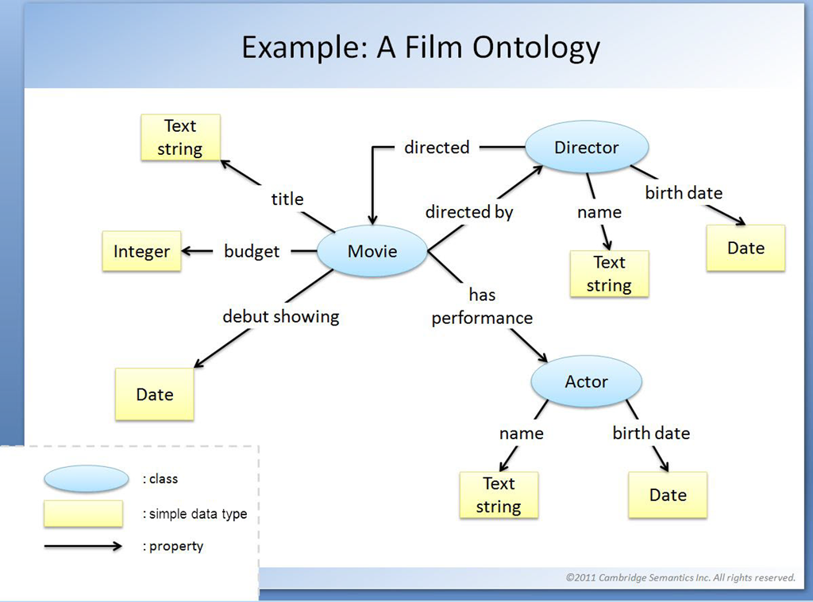
Simple
Movie
Horror
Crime
Science
Fiction
. . .
. . .

Slide 8
Simple
Movie
Horror
Love
Science
Fiction
. . .
. . .
: instance

Slide 9
Simple
Movie
Horror
Love
Science
Fiction
. . .
. . .
Tom Cruise
Star Wars
Alien
: instance

Slide 10
What’s inside an ontology?
Classes + class-hierarchy
instances
slots/values
inheritance
restrictions on slots (type, cardinality)
properties of slots (symm., trans., …)
relations between classes (disjoint, covers)
reasoning tasks: classification, subsumption
This week
Next week

Slide 11





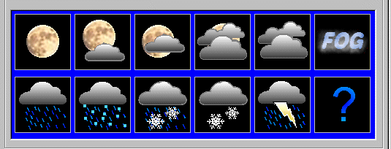
Real life examples
handcrafted
music: Music ontology , MusicMoz (1073/7)
biomedical: SNOMED (200k), Gene Ontology GO (15k), Emtree(45k+190k Systems biology
ranging from lightweight
UNSPC, Open directory (400k) to heavyweight (Cyc (300k))
ranging from small (METAR) to large (UNSPC)

Slide 12






















































Notes:
From ivo@velitchkov.eu
1. For Morgan Stanley etc see case studies of Top Quadrant
2. For Voklswagen, Nokia, Daimler, Bosch, I couldn't find quickly an online resource but they are all clients of eccenca
3. I can't remember seeing Schneider Electric, which are heavy RDF user. You can find them along many others on Stardog's customer page
4. Philips, CreditSuise etc at PoolParty customer page.
5. Taxonic is now implementing Asset Managemnt system based on RDF at Schihol Airport but you should ask Jan if they are fine to associate their logo with that
6. I saw the logo of the European Commission, but not of European Council (SPARQL: http://data.consilium.europa.eu/sparql ) and Publications Office (SPARQL: http://publications.europa.eu/webapi/rdf/sparql)

Slide 13
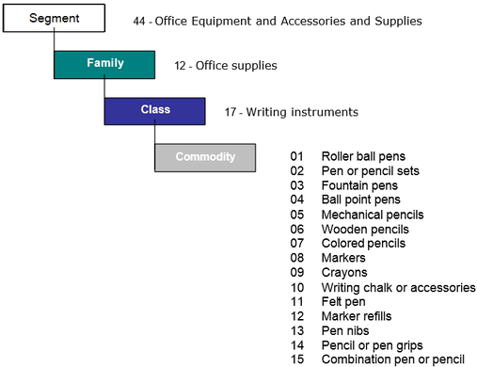
UNSPC Product and services

Slide 14
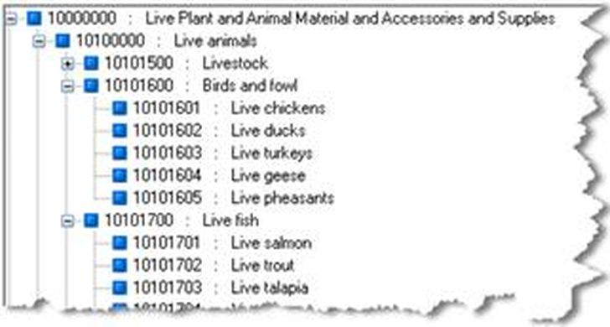
UNSPC Product and services

Slide 15
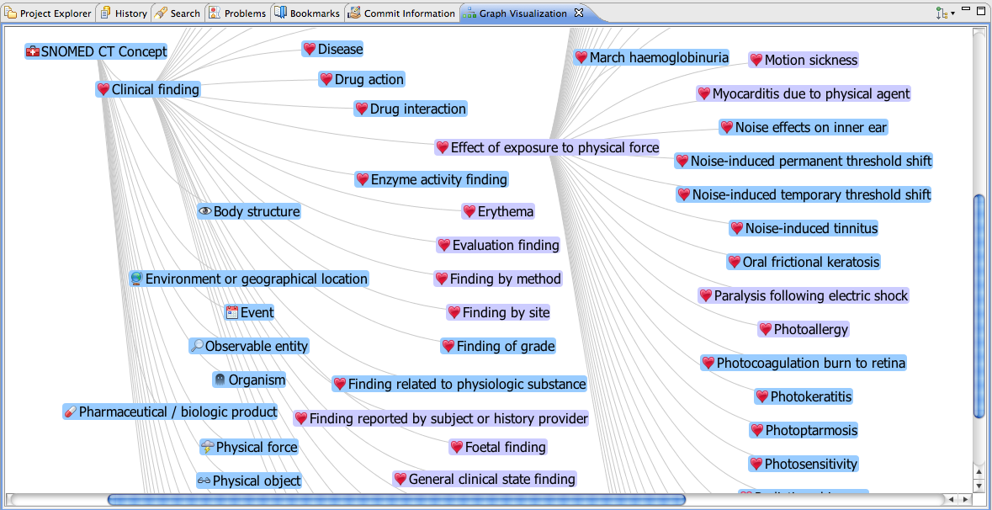
SNOMED: used in healthcare

Slide 16
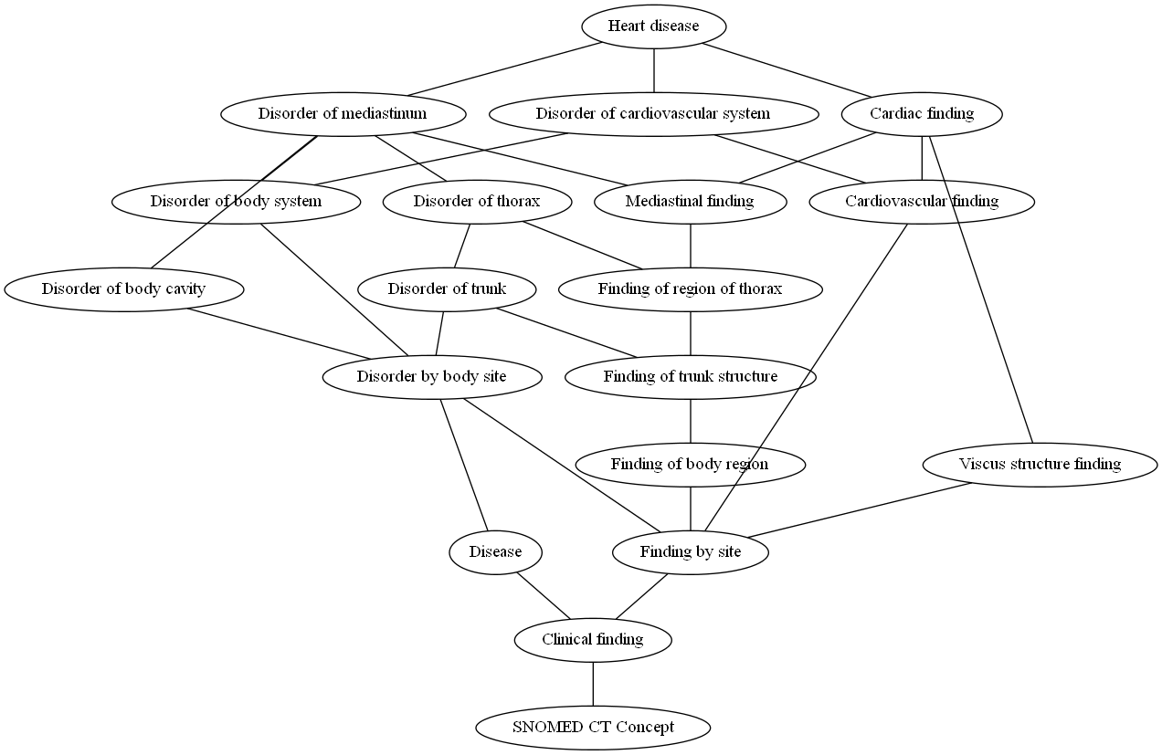
SNOMED: used in healthcare

Slide 17
Biomedical ontologies (a few..)
Mesh
Medical Subject Headings, National Library of Medicine
22.000 descriptions
EMTREE
Commercial Elsevier, Drugs and diseases
45.000 terms, 190.000 synonyms
UMLS
Integrates 100 different vocabularies
SNOMED
200.000 concepts, College of American Pathologists
Gene Ontology
15.000 terms in molecular biology
NCBI Cancer Ontology:
17,000 classes (about 1M definitions),

Slide 18
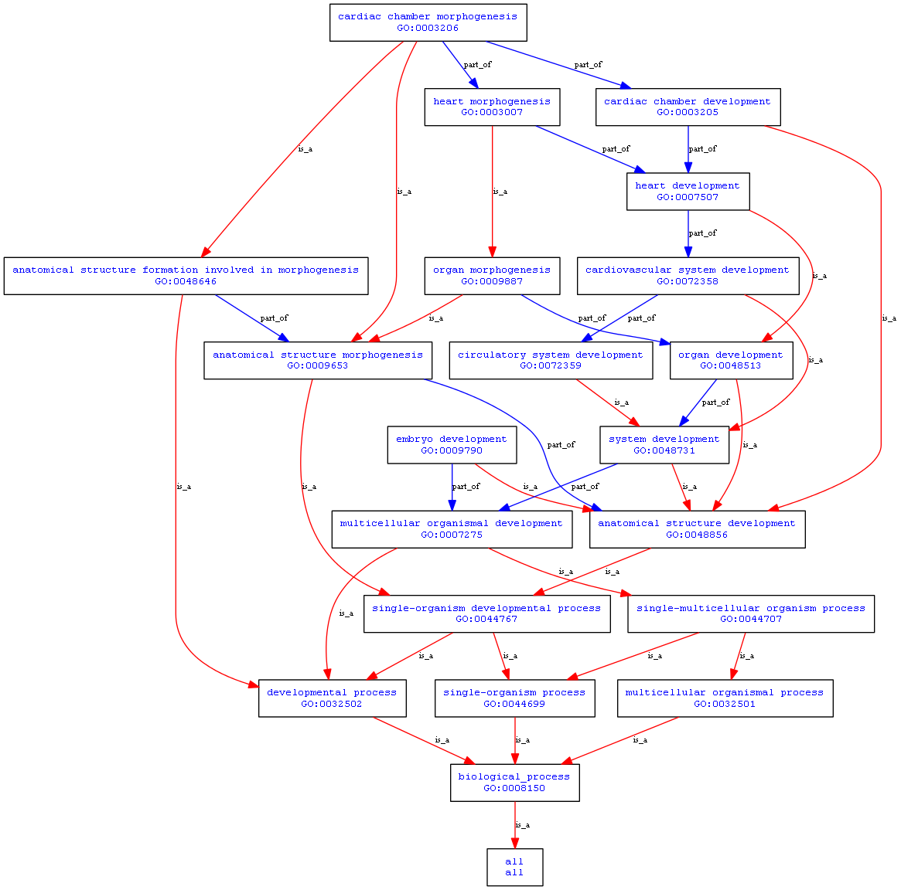
Gene Ontology

Slide 19
Gene Ontology

Slide 20
Applications
used by
media: BBC, Reuters, New York Times,
governments
retail (10K companies): BestBuy, Sears, Kmart, Volkswagen, Renault
IT: IBM, Oracle
Search: Bing, Yahoo, Google

Slide 21
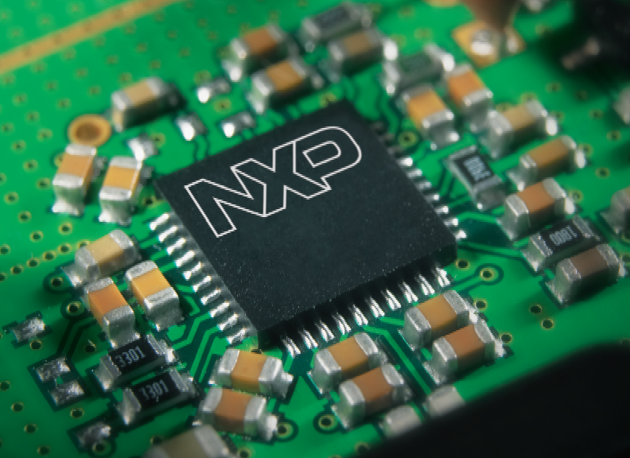
NXP is a semiconductor (microchip) manufacturer
50+ years of experience in semiconductors
Headquarters: Eindhoven, The Netherlands
Customers include Apple, Bosch, Continental, Delphi, Gemalto, Giesecke/Devrient, Huawei, NSN, Panasonic and Samsung
Portfolio of 26,000+ products: microchips for location, temperature, speed, etc. at 5V, 12V, 16V, …, large, small, tiny, …
Their own engineers could no longer find what products they had already designed
Notes:
This company had so many variations on their products that their own engineers couldn’t find the specs of each others designs any more.

Slide 22
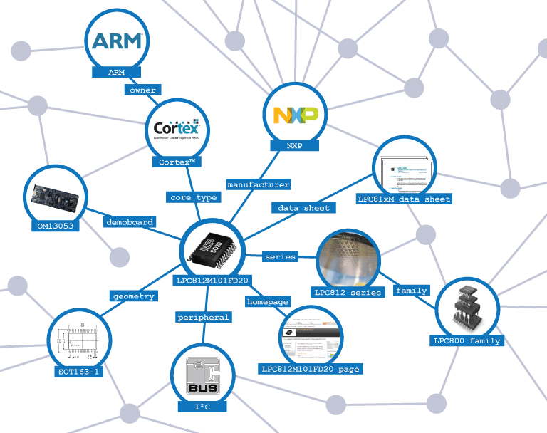
They built their own ontology

Slide 23
NXP: data integration about 26.000 products
Knowledge Base = Ontology + instances
Departments
Knowledge Base
Customers
Notes:
After it was such a success for their own engineers, they also made portions of it open to their customers.

Slide 24
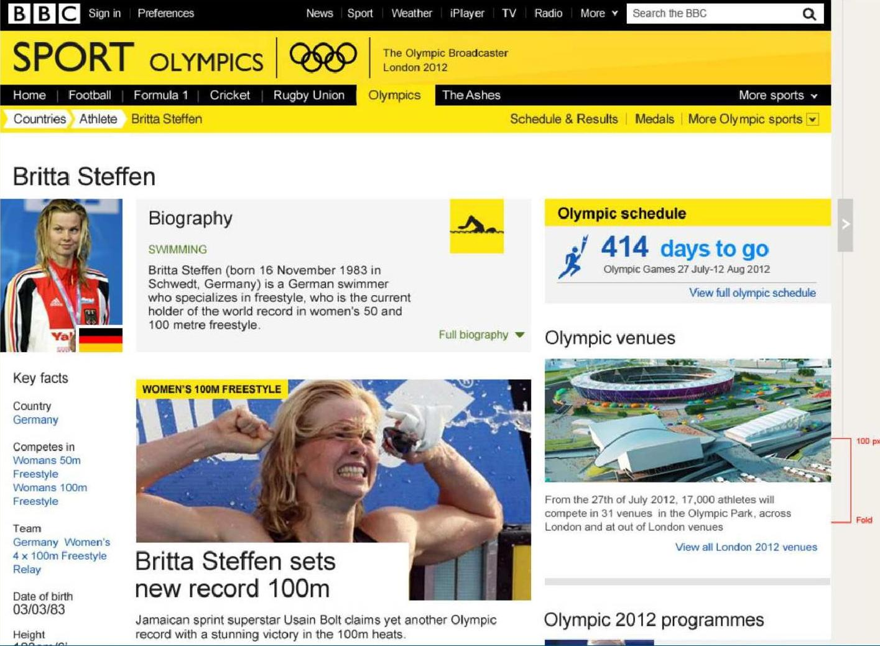
Notes:
Journalists re-use bits of information, text and images from other journalists all the time. Semweb technology made that process more efficient. The BBC website, powered by SemWeb technology was the busiest website in the world during the London Olympic Games.

Slide 25
BBC Olympic Games website
During the 2012 Olympic games this was the busiest website in the world
Even journalists could no longer find if they had written about a certain athlete, or a certain event

Slide 26
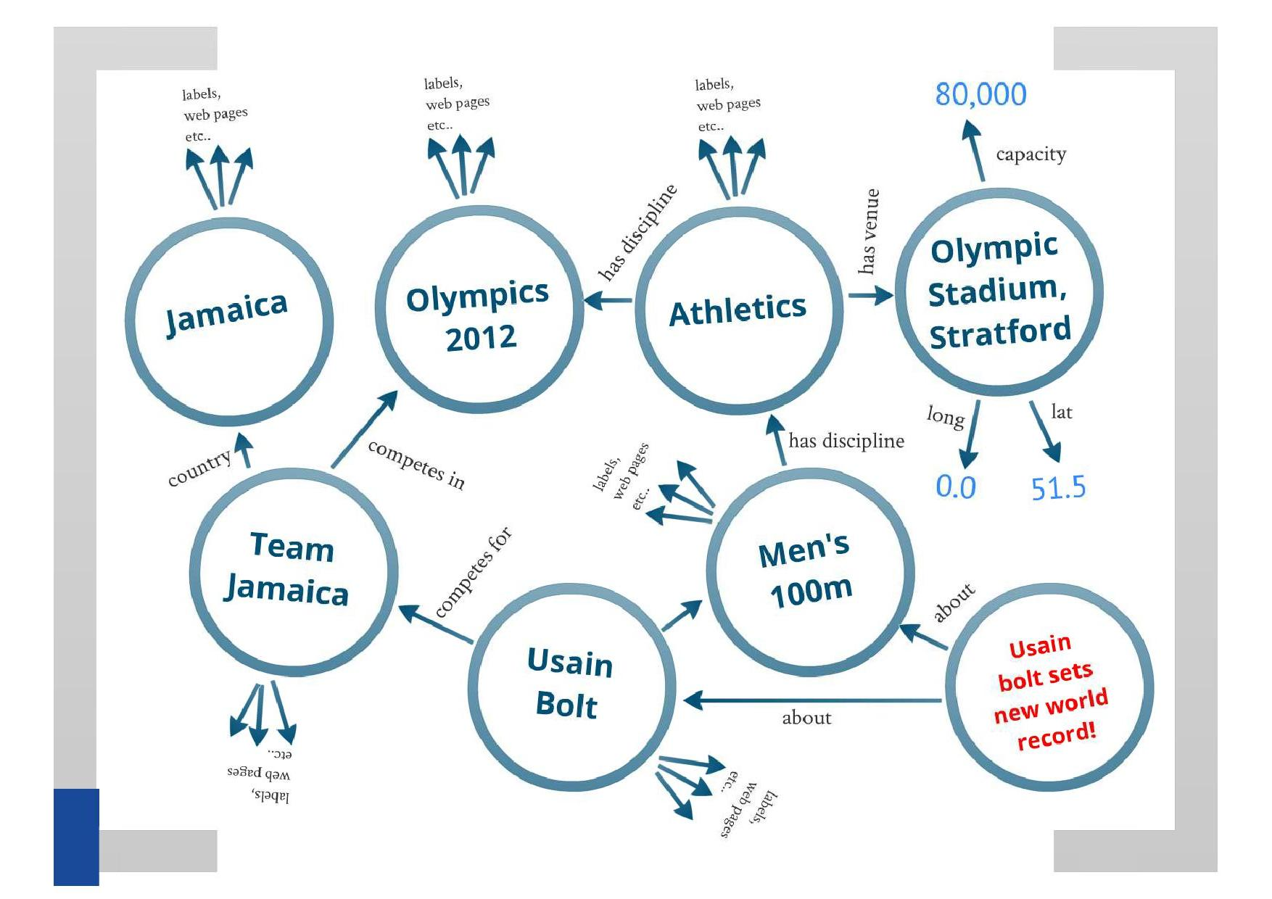
BBC Olympics ontology
Notes:
And yes, just as XMP made an ontology about their electronic products, the BBC made an ontology about Olympic sports.

Slide 27
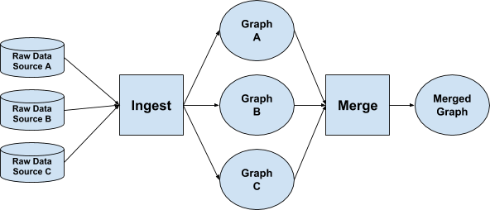
Uber
“When an eater enters a query, we try to understand their intent based on our knowledge of food organized as a graph” Uber Engineering blog, June 6 2018

Slide 28
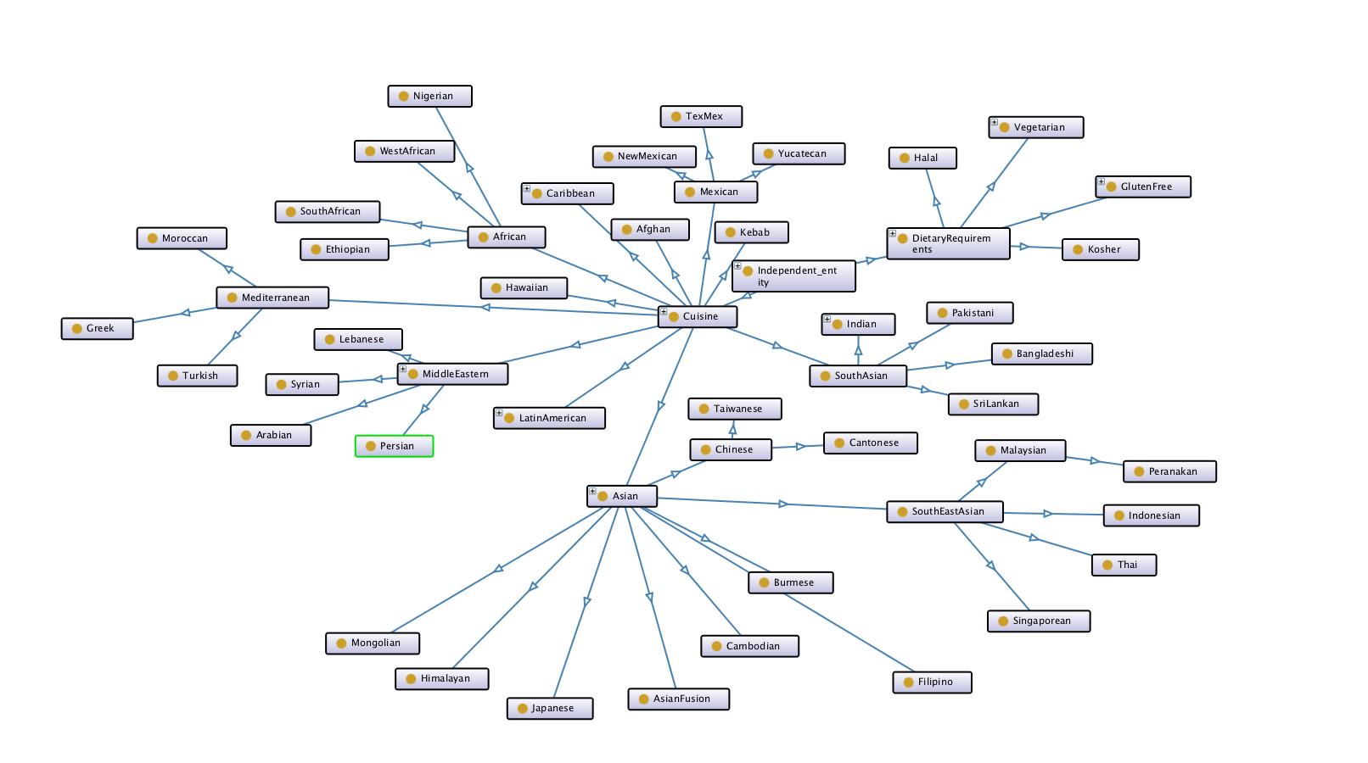
Uber Food ontology

Slide 29
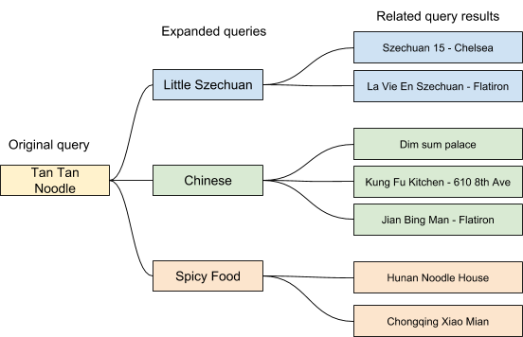
Uber: Query expansion to give optimal suggestions for the order of a customer

Slide 30
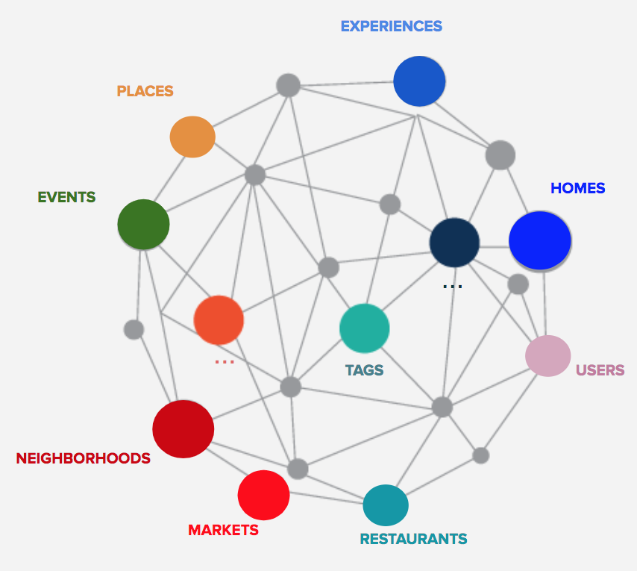
Airbnb: to give optimal advice on which holiday address to book
https://medium.com/airbnb-engineering/scaling-knowledge-access-and-retrieval-at-airbnb-665b6ba21e95

Slide 31
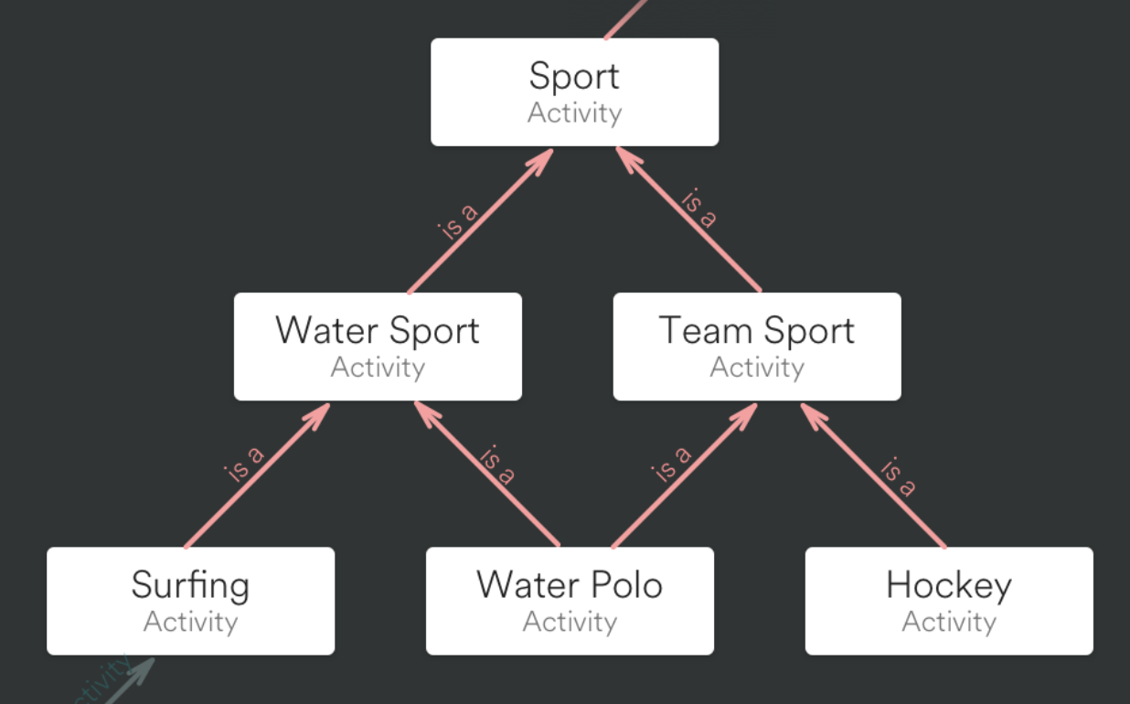
Airbnb ontology of locations and activities

Slide 32
How to build an ontology
So by now we have seen
what an ontology is
many examples of ontologies
Who are using ontologies
But how do you build an ontology?
(This will be your homework!)

Slide 33
Main Stages in Ontology Development
Determine scope
Consider reuse
Enumerate terms
Define taxonomy
Define properties
Define facets
Define instances
Check for anomalies
Not a linear process!
In the next slides,
we’ll run through these steps in a simple example

Slide 34
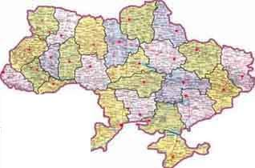
Step 1: Determine Domain and Scope
Domain: geography
Application: route planning agent
Possible questions:
Distance between two cities?
What sort of connections exist between two cities?
In which country is a city?
How many borders are crossed?

Slide 35
Determine Scope
There is no correct ontology of a specific domain
An ontology is an abstraction of a particular domain, and there are always viable alternatives
What is included in this abstraction should be determined by
the use to which the ontology will be put
by future extensions that are already anticipated

Slide 36
Determine Scope (2)
Basic questions to be answered at this stage are:
What is the domain that the ontology will cover?
For what we are going to use the ontology?
For what types of questions should the ontology provide answers?
Who will use and maintain the ontology?

Slide 37
Consider Reuse
With the spreading deployment of the Semantic Web, ontologies have become more widely available
We rarely have to start from scratch when defining an ontology
There is almost always an ontology available from a third party that provides at least a useful starting point for our own ontology

Slide 38
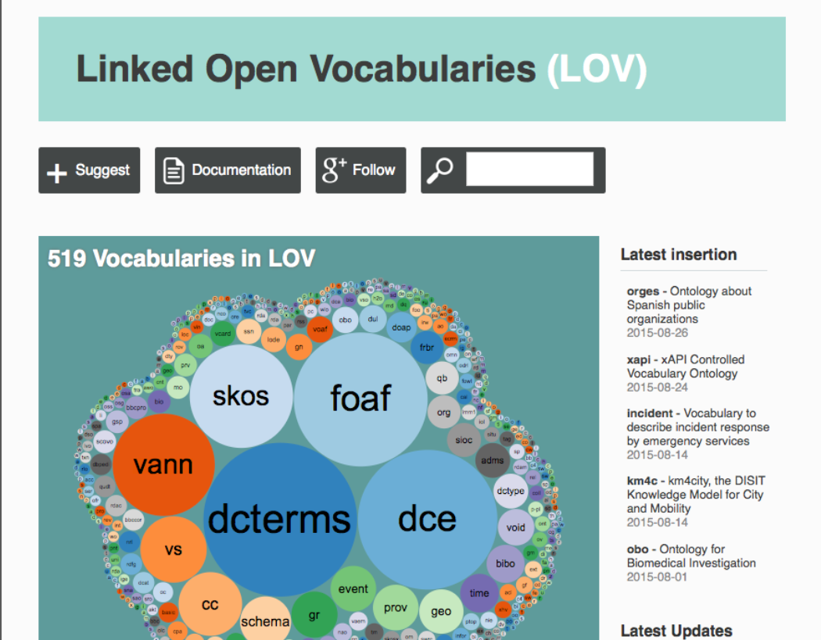

Slide 39
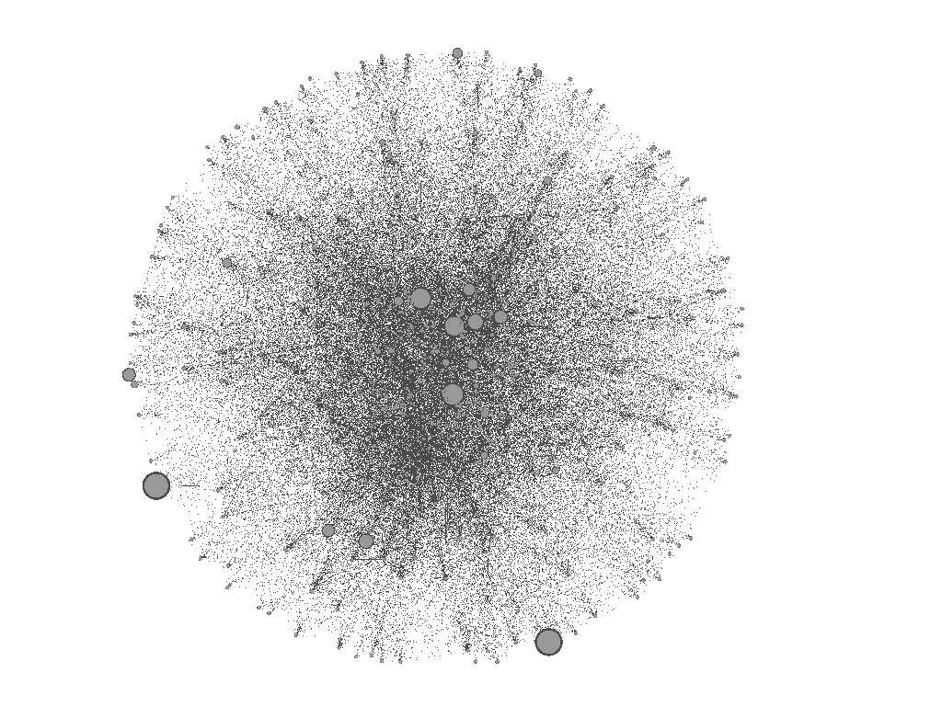
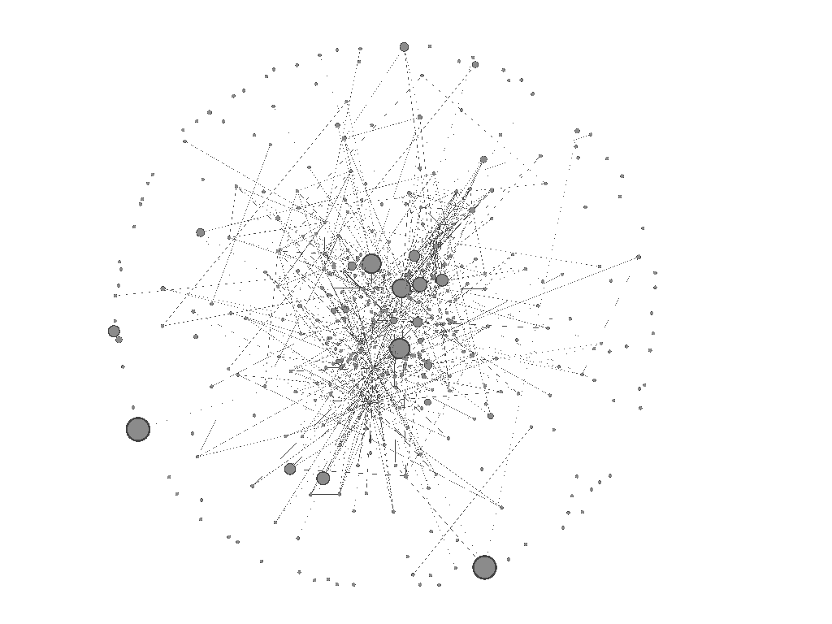
Bio-medical
ontologies in
Bio-portal
> 5 links

Slide 40
Enumerate Terms
Write down in an unstructured list all the relevant terms that are expected to appear in the ontology
Nouns form the basis for class names
Verbs (or verb phrases) form the basis for property names
Traditional knowledge engineering tools (e.g. laddering and grid analysis, card sort, 20 questions) can be used to obtain
the set of terms
an initial structure for these terms

Slide 41

Step 2: Enumerate Important Terms
city
capital
Connection_on_land
country
border
road
railway
Connection_on_water
currency
Connection_in_air
connection

Slide 42
Define Taxonomy
Relevant terms must be organized in a taxonomic hierarchy
Opinions differ on whether it is more efficient/reliable to do this in a top-down or a bottom-up fashion
Ensure that hierarchy is indeed a taxonomy:
If A is a subclass of B, then every instance of A must also be an instance of B (compatible with semantics of rdfs:subClassOf

Slide 43
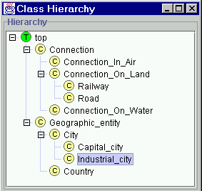
Step 3: Define Classes and Class Hierarchy

Slide 44
Define Taxonomy
The semantics of subClassOf demands that whenever A is a subclass of B, every property statement that holds for instances of B must also apply to instances of A
It makes sense to attach properties to the highest class in the hierarchy to which they apply

Slide 45
Popular mistakes
Which of these is NOT a class:
(a) Chef, (b) Jamie Oliver, (c) Apple, (d) Fruit
Is this a correct hierarchy:
Thing
Beverage
Juice
Fruit Juice
Apple
Soda
Coca Cola

Slide 46
Popular mistakes
And is this a correct hierarchy:
Thing
Meal
Breakfast
Eggs
Lunch
Late Lunch
Dinner
Pasta

Slide 47
Issues on class hierarchy
A
- all is-a relations hold?
Inst(B) ⊂ Inst(A)
B
C
D
- check transitivity
C Subclass_of(A)
D Subclass_of(C)
D Subclass_of(A)
- avoid unexpected cycles
B Subclass_of(A)
A Subclass_of(B)
A=B

Slide 48
Define Properties
While attaching properties to classes, it makes sense to immediately provide statements about the domain and range of these properties
There is a methodological tension here between generality and specificity:
Flexibility (inheritance to subclasses)
Detection of inconsistencies and misconceptions

Slide 49
Step 4: Define Slots of Classes
Geographic_entity
End_point
Connection
Country
City
Start_point
Has_capital
Borders_with
Capital_of
Capital_city
Step 5: Define slot constraints
Slot-cardinality
Ex: Borders_with multiple, Start_point single
Slot-value type
Ex: Borders_with- Country

Slide 50
Define Slots
Domain & range
Cardinality restrictions
Relational characteristics
symmetry, transitivity, inverse properties, functional values

Slide 51
Issues on Slots
- inverse slots (redundant, but explicit)
Has_capital
Country
Capital_city
Capital_of
-symmetric slots
Ex. A borders_with B
B borders_with A
-transitive slots
A.connection(B)
B.connection(C)
A.connection(C)

Slide 52
Domain / Range
What is a reasonable domain of the has-taste relation?
Sweet
Is-hotter-than
Fruit
Foood
Taste
Which of these is a reasonable range?

Slide 53
Properties
Transitive properties.
Example: colleague
Counter-example: friend
Symmetric properties
Example: friend
Counter-example: son
Functional properties
Example: mother
Counter-example: sister
Person 1
Person 2
Person 3
Person 1
Person 2
Person 1
Person 2
X
Person 3

Slide 54
Define Instances
Filling the ontologies with such instances is a separate step
Number of instances >> number of classes
Thus populating an ontology with instances is not done manually
Retrieved from legacy data sources (DBs)
Extracted automatically from a text corpus

Slide 55
Main Stages in Ontology Development
Determine scope
Consider reuse
Enumerate terms
Define taxonomy
Define properties
Define facets
Define instances
Check for anomalies (We’ll do this next week: machine reasoning)

Slide 56
Your homework for this week
Make a music-ontology of 20 classes + properties + instances
Use a professional ontology editor (Protégé)
See the assignment and the tips
Hand in:
A picture of your class hierarchy
A description of the properties
A discussion of your design decisions
An analysis of the strength and weaknesses of your ontology

